Slide 1

Dog Event Tracker Project
By: Eli Langille

Slide 2
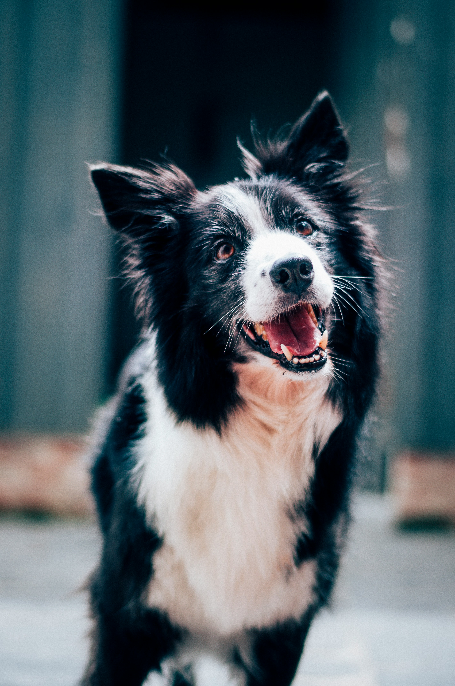
GoalS
Improve organization of pet maintenance
Keep track of past events
Provide scheduling and reminders for future events

Slide 3
Features
Add events
Extensive and flexible parameters
View by time range
View by type
Live-time reminders
Do not disturb

Slide 4
Challenges
Maintaining best practices and SOLID principles
Reminder integration and flow

Slide 5
Thank you

